Slide 1
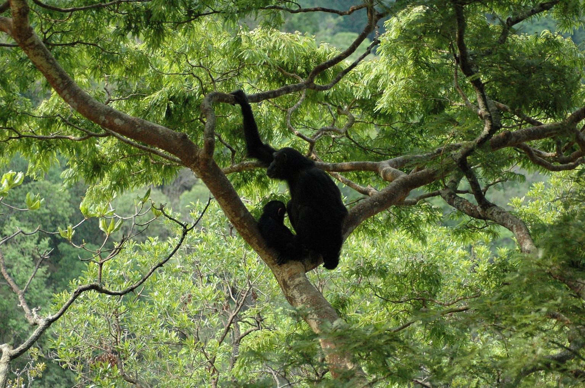


A decision support system to monitor chimpanzee habitat health in Africa using Landsat satellite imagery, crowdsourcing and open standards
Lilian Pintea – the Jane Goodall Institute, Sam Jantz – University of Maryland
Janet Nackoney – University of Maryland, Matthew C. Hansen – University of Maryland

Slide 2

The Jane Goodall Institute (JGI) - created in 1976 to continue Dr. Jane Goodall’s chimpanzee research in Gombe, Tanzania

Slide 3
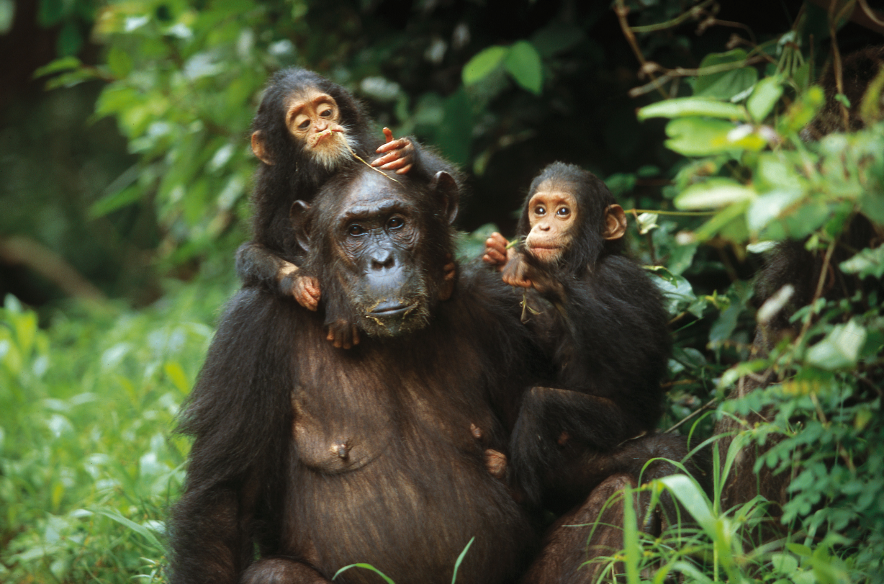
Gombe Stream RC - the longest running great ape research site in the world
Extensive long-term social, behavioral and ecological records
Behavioral data collected daily at 15-minute intervals
Since 1960 …more than 400,000 observations.

Slide 4
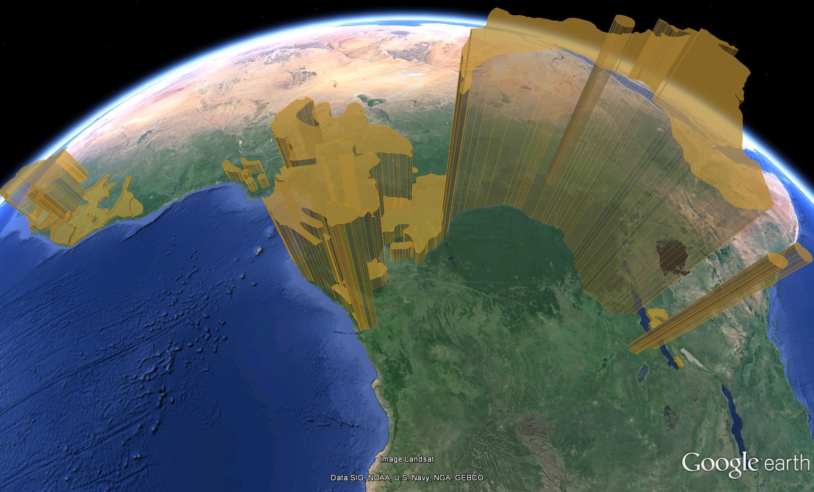
the Jane Goodall Institute’s 30-year Mission Goal:
To protect with partners 85% of chimpanzees and their habitats in Africa

Slide 5
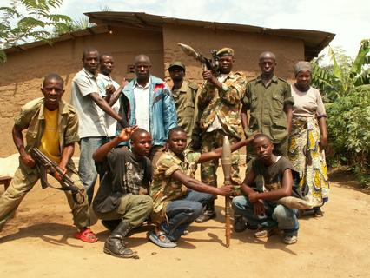
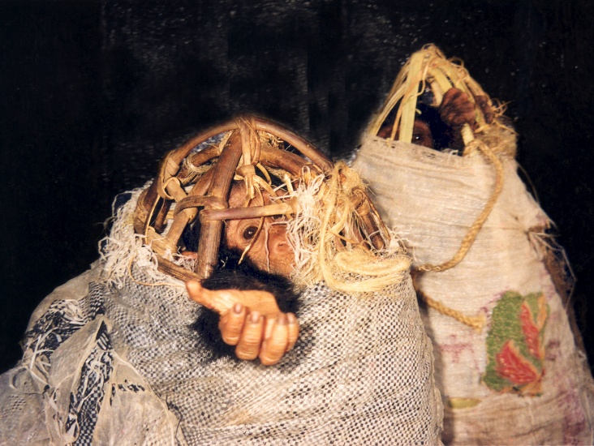
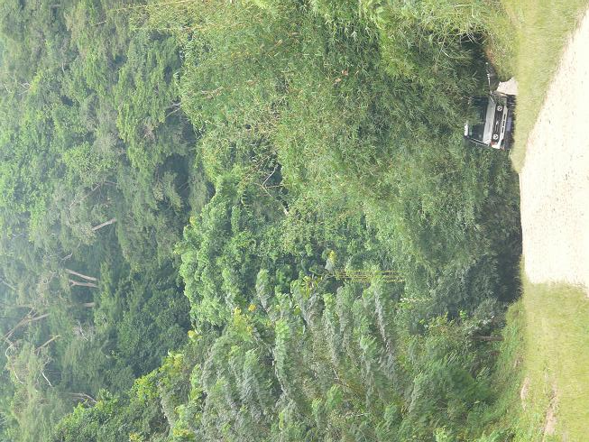
Threats to chimpanzees in the Congo Basin
Insecurity
Bushmeat hunting
Unregulated Mining
Low protection capacity
Live infant capture
Improved accessibility

Slide 6
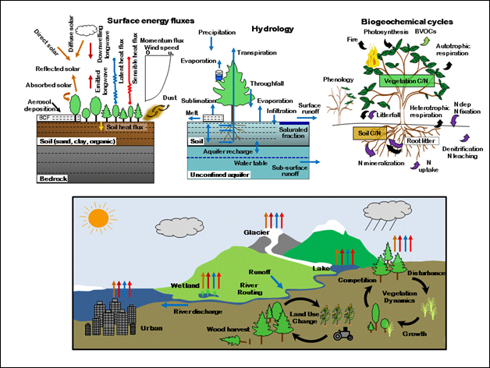
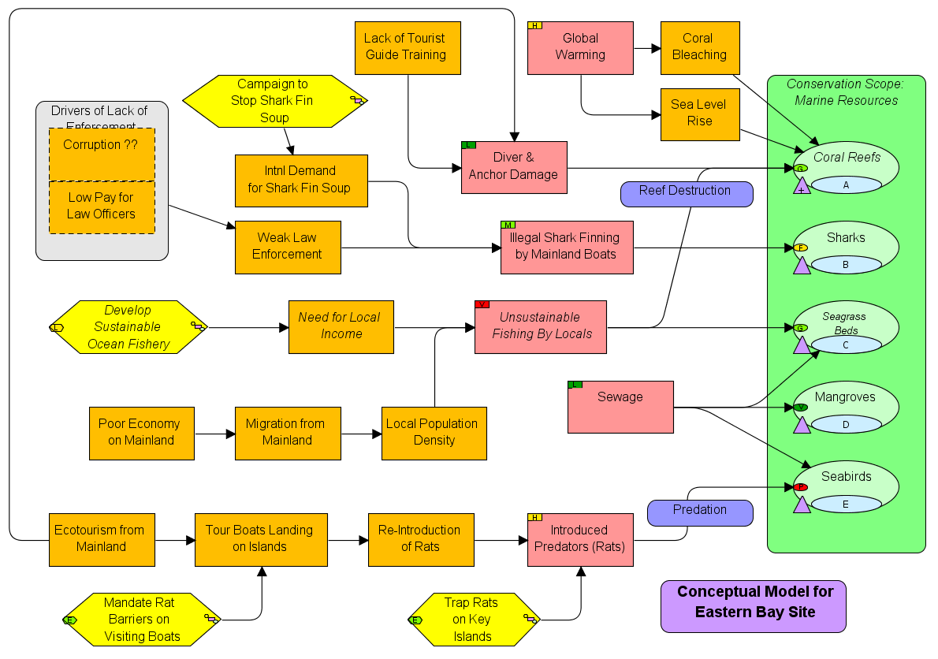
Understanding how the world works
Understanding how to make better conservation decisions
Lawrence, D.M. and R. Fisher, 2013
Open Standards for the Practice of Conservation
http://cmp-openstandards.org/

Slide 7

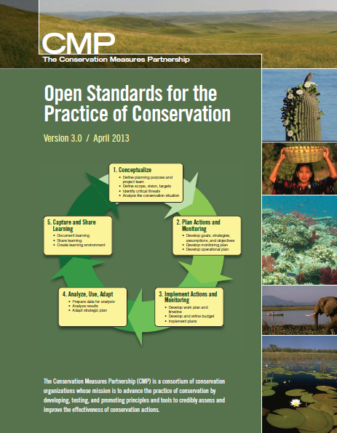
Open Standards for the Practice of Conservation
Developed by leading orgs & agencies
Draws on many fields
Open source &
common language
Used around the world
  State Wildlife Agencies
  National Park Systems
  Donor Funding Programs
  Academic Training
Notes:
Version 3.0 was published in April 2013 and was a joint effort between many individuals and organizations.

Slide 8
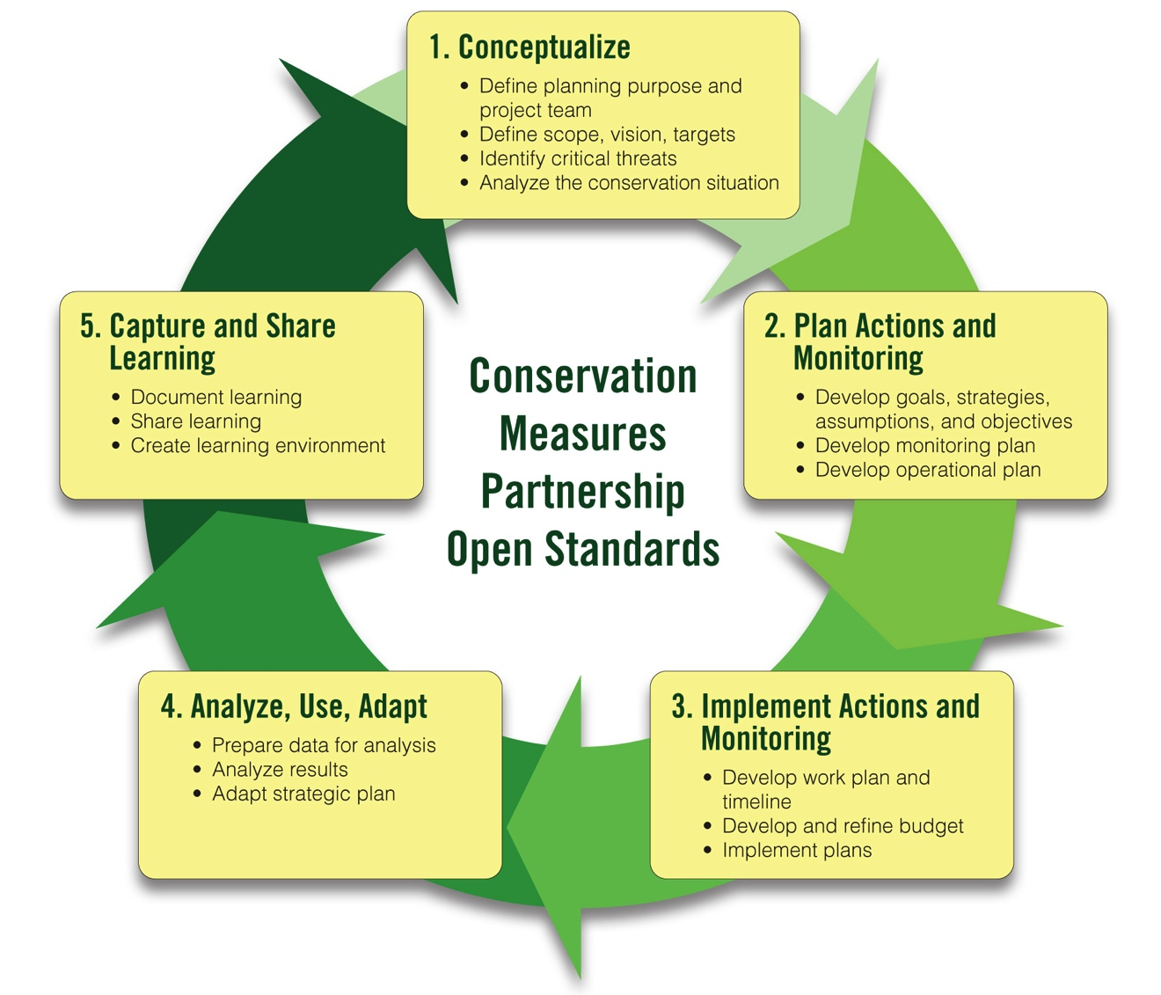
www.conservationmeasures.org

Slide 9
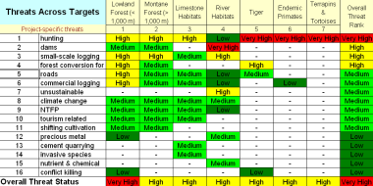
Brief Summary of the Open Standards
Summarize what you want to conserve
Understand current & desired condition
Identify and rank threats
Develop a general model of socioeconomic-ecological system
Identify strategies based on the general model
Define theories of change to show how strategies will work
Implement the strategies, checking as you go
Adjust
Notes:
Diagram icons are there to refer to the steps in Miradi (you could remove if you are not using the software but they might also be helpful).

Slide 11
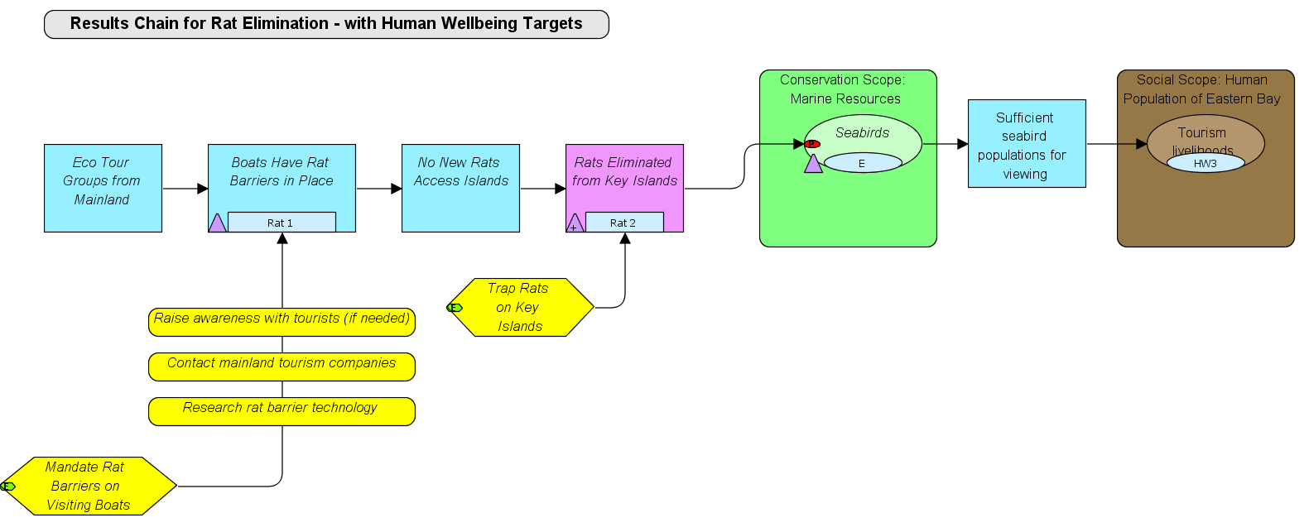

Slide 12
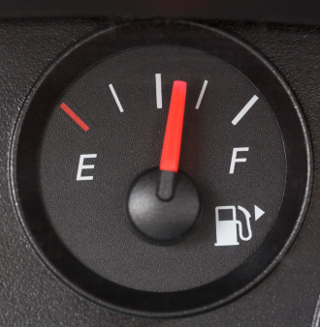
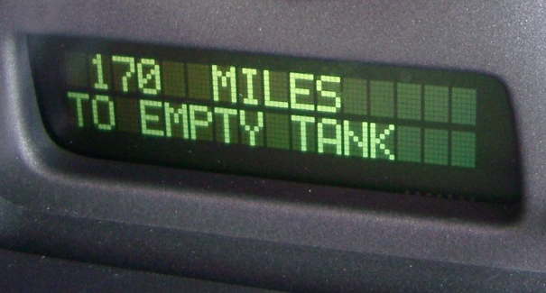
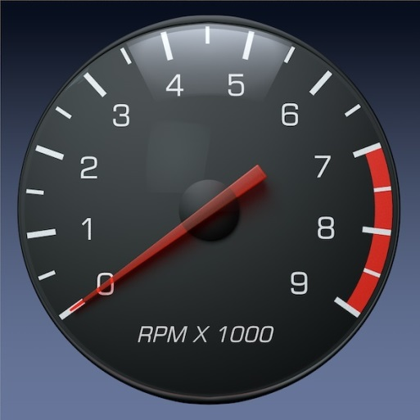
Focusing on actionable info to support decisions
Gas Gauge
Info need
Actual measurement
Interpretive markings
to trigger action
Tachometer
Info need
Actual measurement
Interpretive markings
to trigger action
Source: Nick Salafsky, Foundation of Success

Slide 13
How Do We Develop Analogous
Dashboard Gauges for Conservation Status?
Viability Analysis - A process that helps conservation project teams explicitly and clearly define healthy targets.
Source: Nick Salafsky, Foundation of Success
Notes:
Step 3 - Viability Analysis
23 April 2015
TNC & Foundations of Success
13

Slide 14
Viability Analysis:
Define key ecological attributes (KEAs) for your target
Identify indicator(s) for each KEA
Develop a rating scale for each indicator, using the categories of Very Good, Good, Fair, or Poor.
Set the current status and the desired future status
for your target
Source: Nick Salafsky, Foundation of Success
Notes:
Step 3 - Viability Analysis
23 April 2015
TNC & Foundations of Success
14

Slide 15
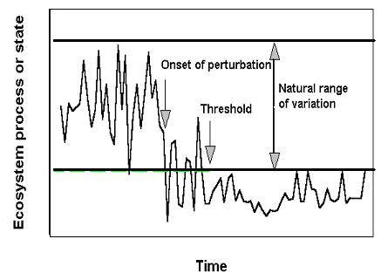
Develop Rating Scale for Indicator
Based on “Acceptable Range of Variation”
Source: Nick Salafsky, Foundation of Success
Notes:
Step 3 - Viability Analysis
23 April 2015
TNC & Foundations of Success
15

Slide 16
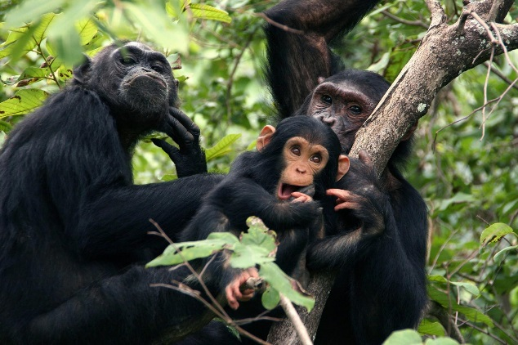
Develop Rating Scale for Indicator
Based on “Acceptable Range of Variation”
Poor:
Restoration increasingly difficult; May result in extirpation
Fair:
Outside acceptable range of variation; Requires intervention to get to good
Good:
Within acceptable range of variation; Some intervention required to maintain
Very Good: Ecologically desirable status; Requires little intervention to maintain
 |  |  |  | Indicator Ratings
Target | Category | KEA | Indicator | Poor | Fair | Good | Very Good
Chimpanzee habitat | Size & Condition | Habitat loss | % Forest loss | ?? | ?? | ?? | ??
Threshold line
Notes:
Step 3 - Viability Analysis
23 April 2015
TNC & Foundations of Success
16

Slide 18
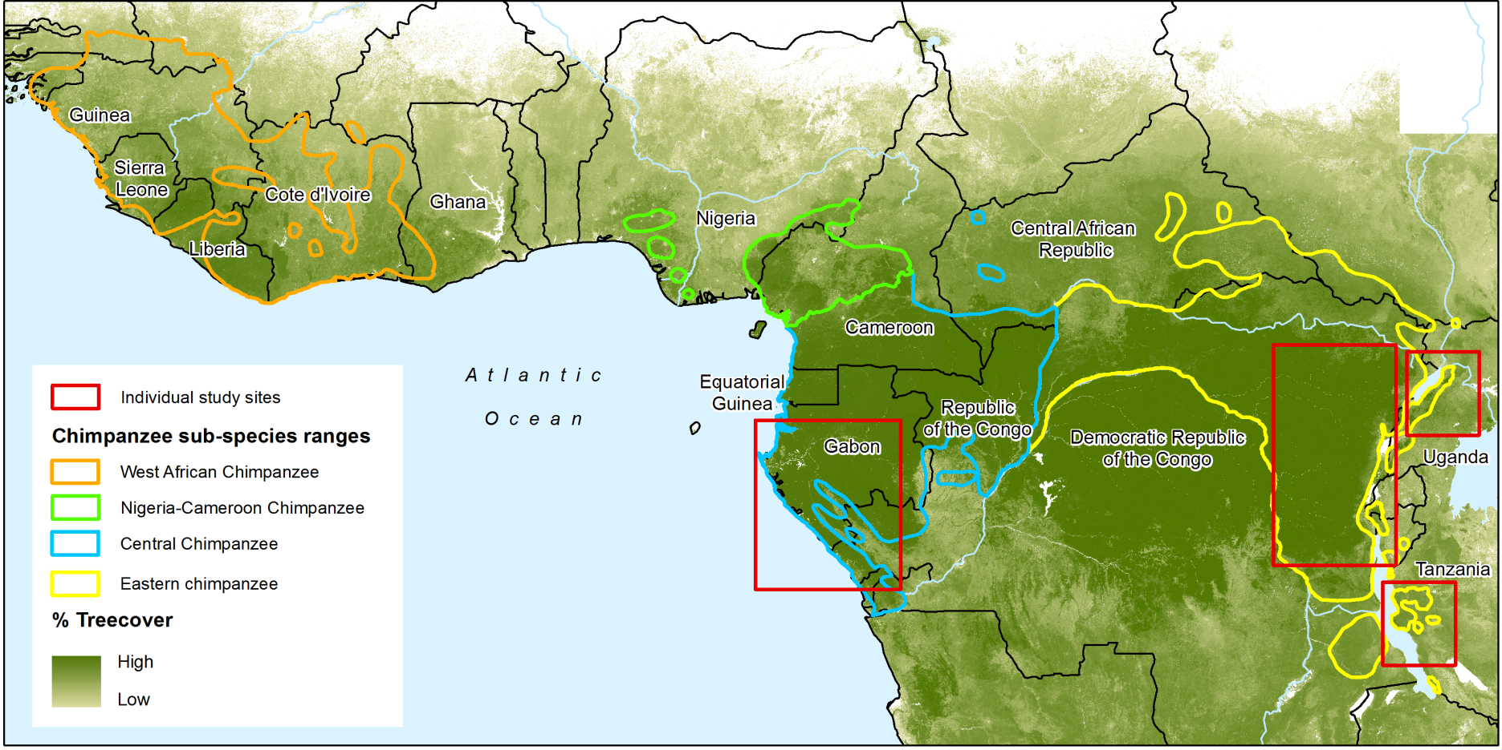
Objective & Geographic Scope
Develop a practical DSS to be used by the Jane Goodall Institute and partners to annually monitor and forecast chimpanzee habitat health in Africa to support decisions using Open Standards.
DSS covers geographic ranges of all four sub-species of chimpanzees.
The feasibility of DSS (Phase 1) was assessed in sub-regions (shown in red) that capture a gradient of the habitat types, ranging from the humid tropical forests of Eastern DRC to the dry savanna woodlands of western Tanzania.

Slide 19
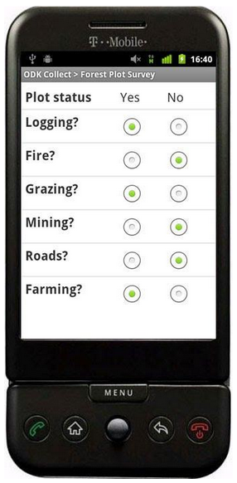
Open Data Kit (ODK)
ODK is a free and out-of-the-box solution for users to:
  build a data collection form or survey,
  collect the data in the field on an Android mobile device, smartphone or tablet,
  aggregate the collected data on a server, locally or in the cloud, and
  extract it in useful formats for analysis and visualization
The Jane Goodall Institute, Google Earth Outreach, University of Washington, and Nafundi has been using (ODK) to support citizen science projects since 2009

Slide 20
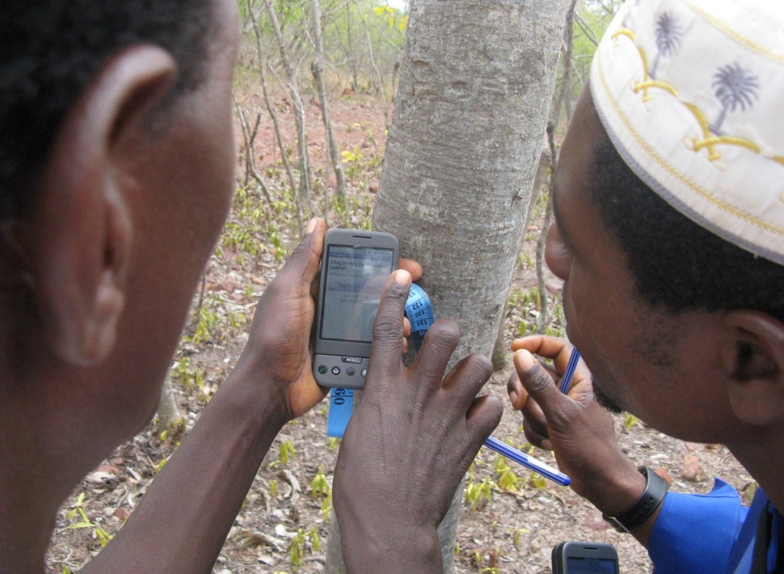
Community Forest Monitors
in Tanzania
ODK training Kigoma, Tanzania, November 2009

Slide 21
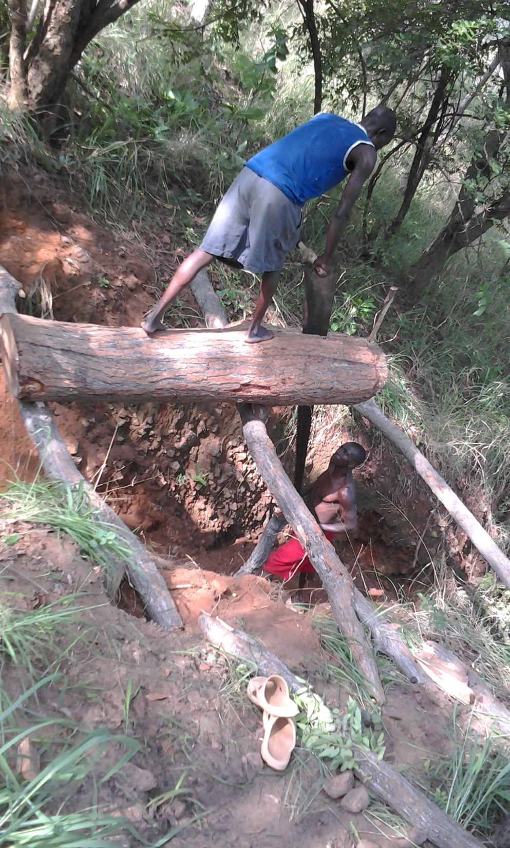
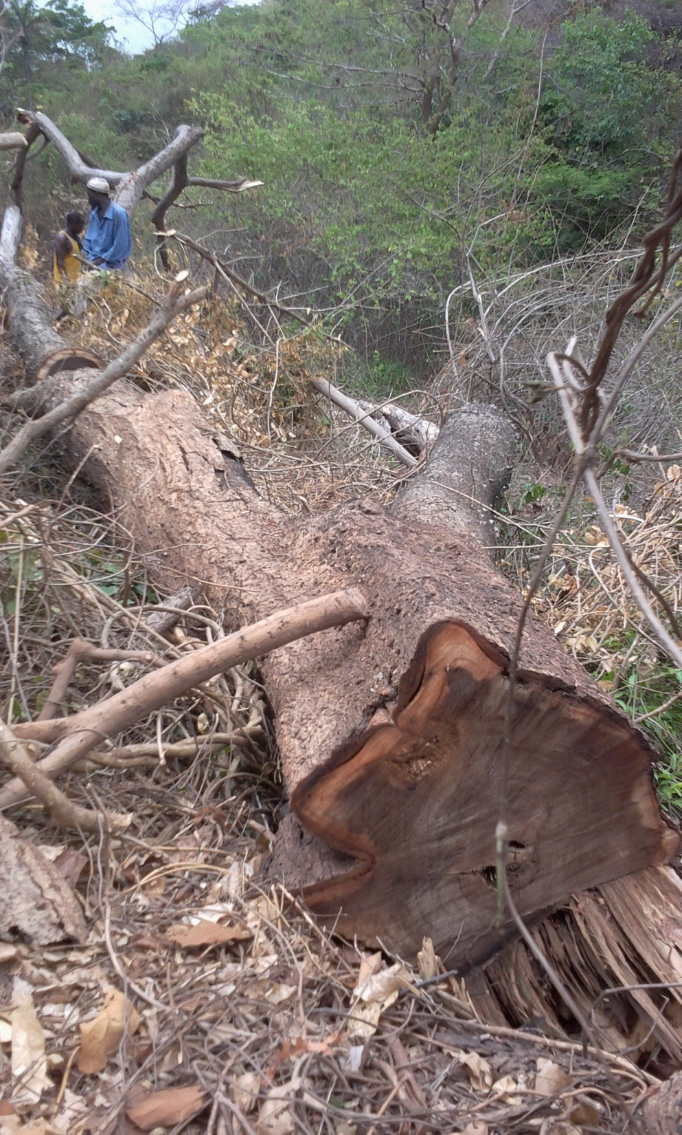
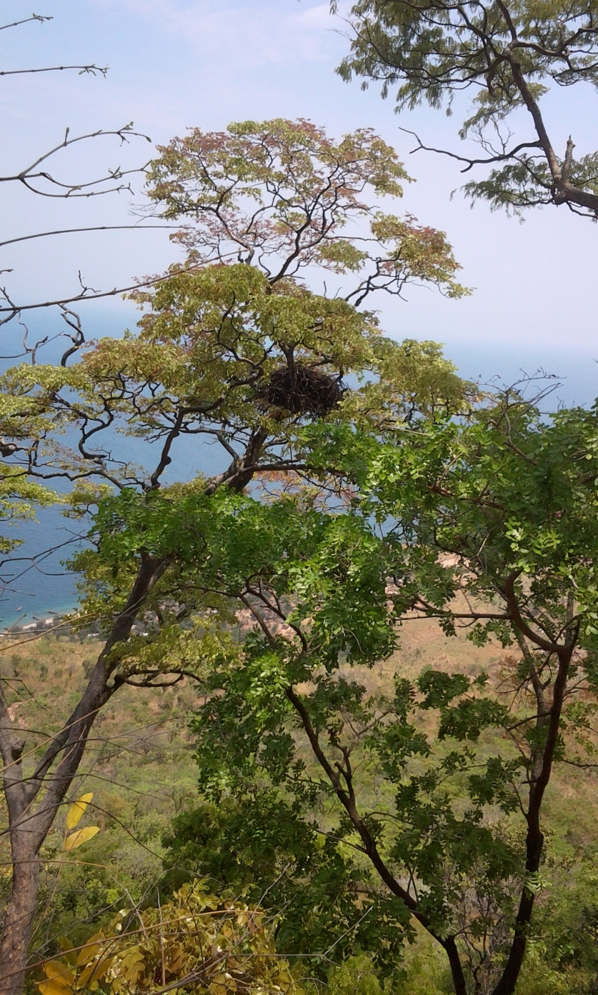
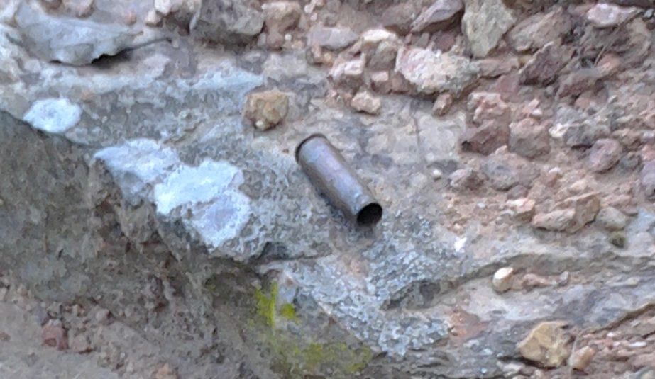

Slide 22
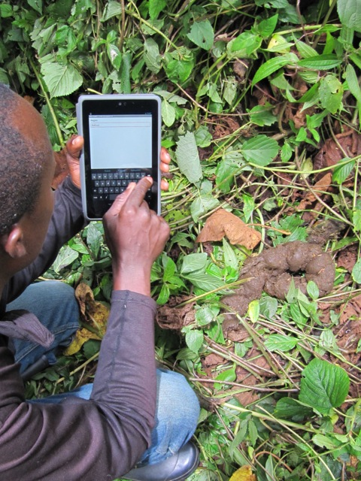
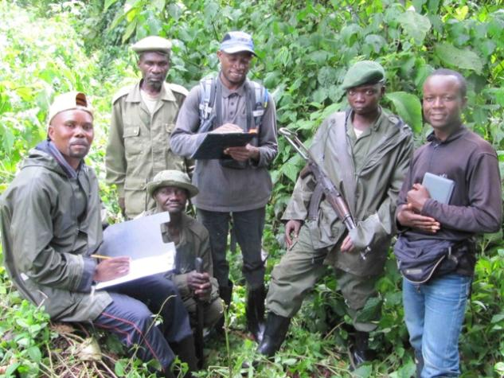
Rangers in DRC:
Chimpanzee and Gorilla Surveys
Chryso Kaghoma, Field Research Assistant (FFI), Eve Cizi Andagamo , ICCN Researcher and Kahuzi Biega National Park rangers
Chryso Kaghoma
Field Research Assistant (FFI)
testing the use of Nexus 7 for chimpanzee and gorilla surveys in Kahuzi Biega National Park (March 14, 2013)

Slide 23
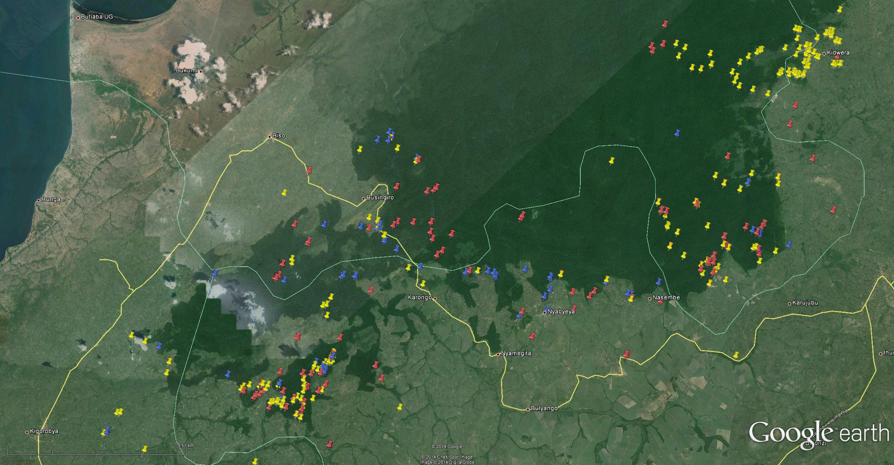
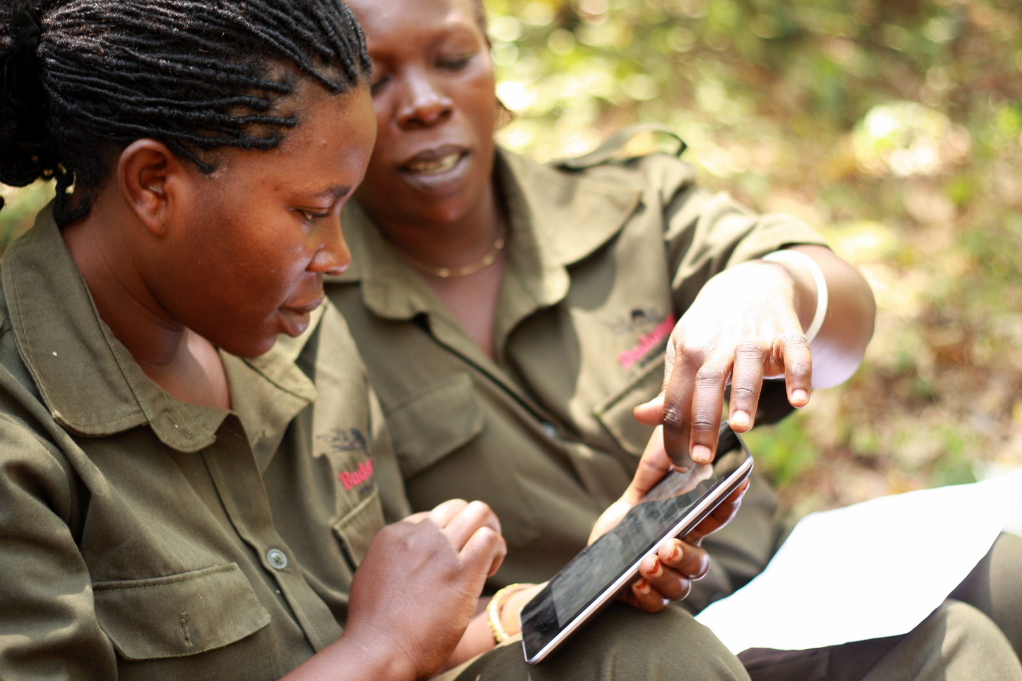
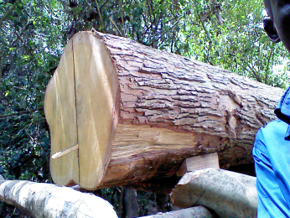
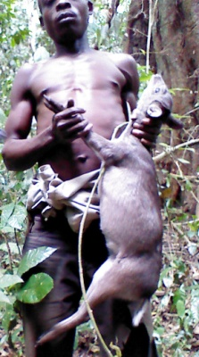
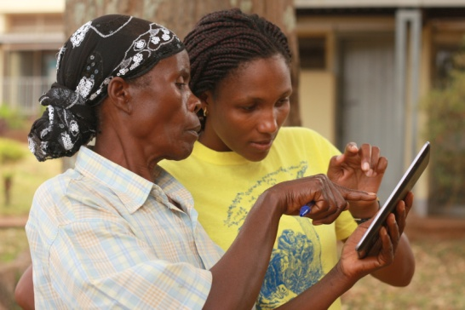
Engaging both communities and rangers in Uganda
Budongo Forest Reserve, Uganda
Illegal activities reported by:
Rangers
Villagers

Slide 24
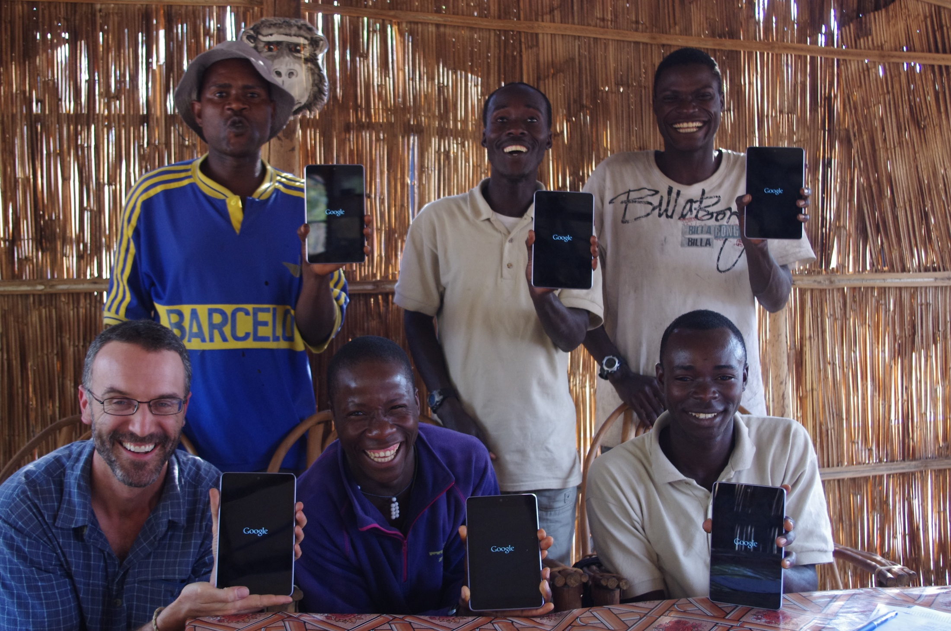
Scientists - Ugalla Primate Project (UPP), Tanzania
Photo: Alex Piel, UPP

Slide 25
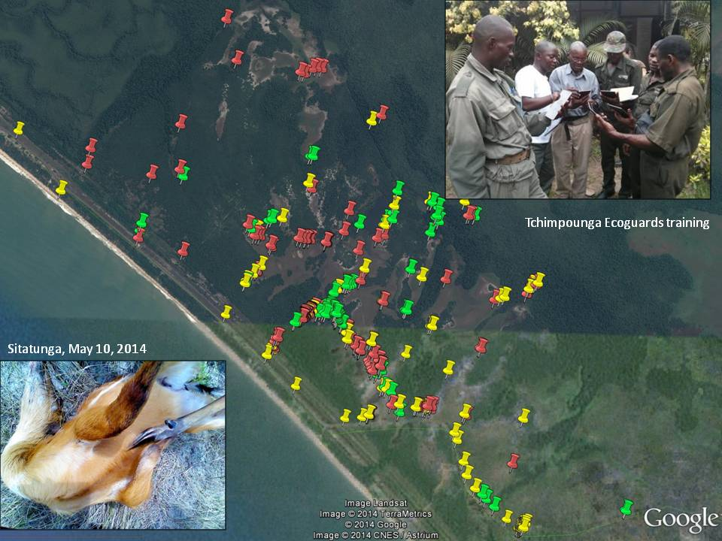
Tchimpounga Nature Reserve, Republic of the Congo

Slide 26
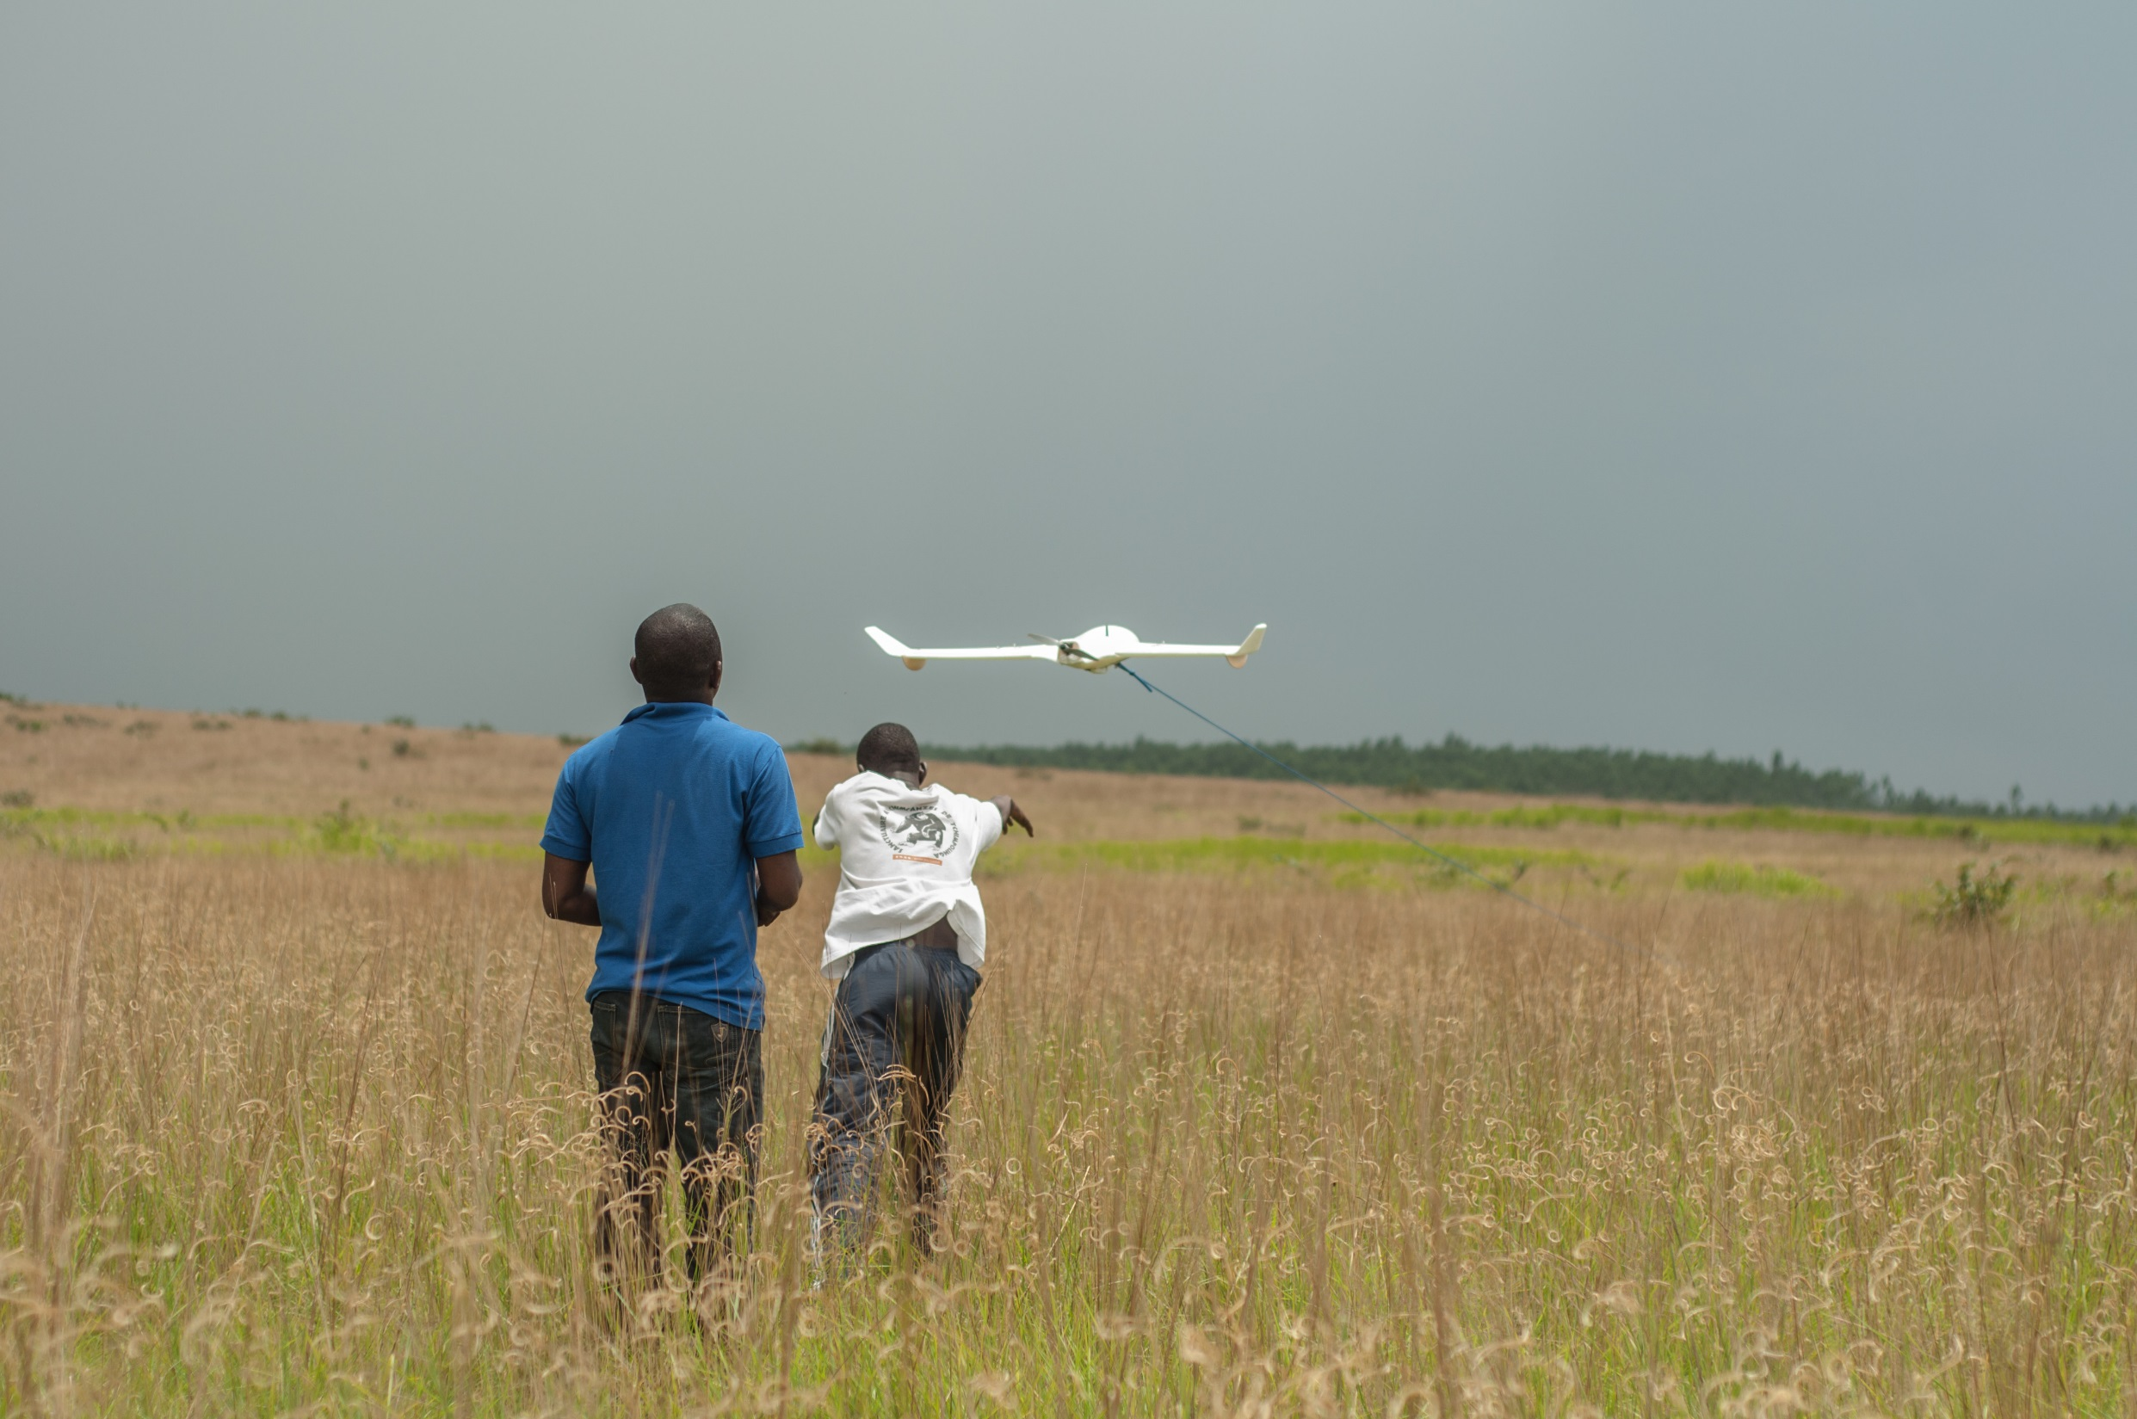
Tchimpounga Nature Reserve, Republic of the Congo

Slide 27
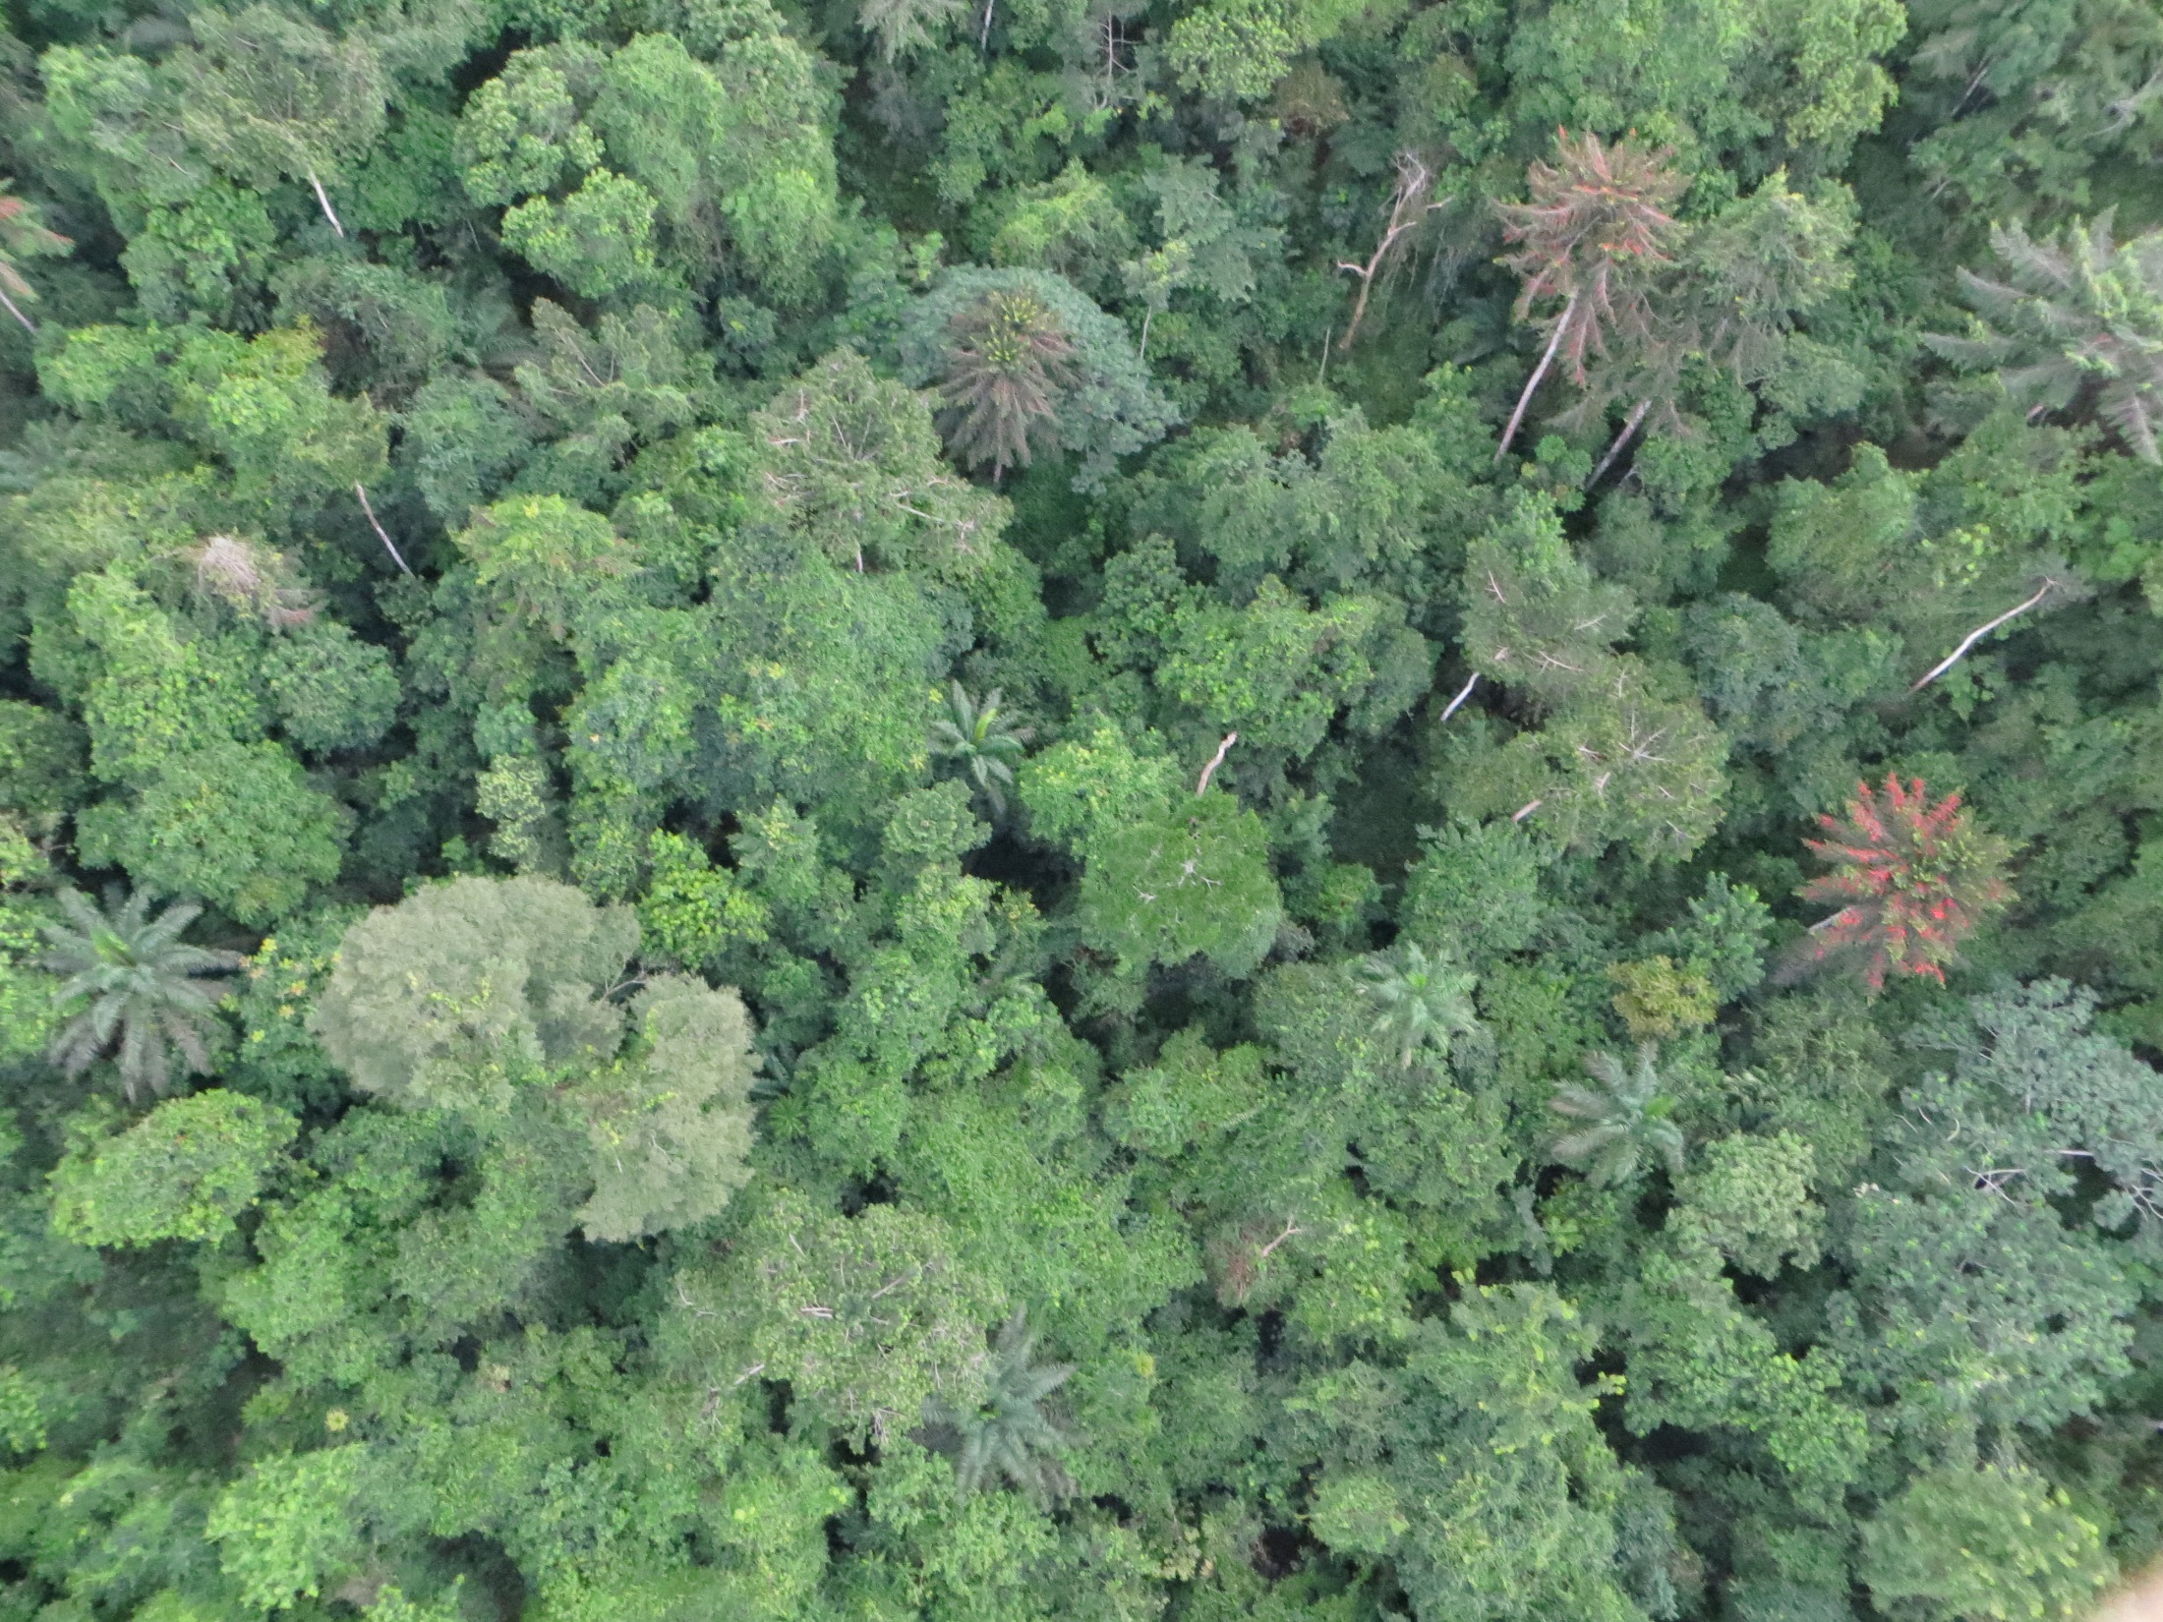

Slide 28
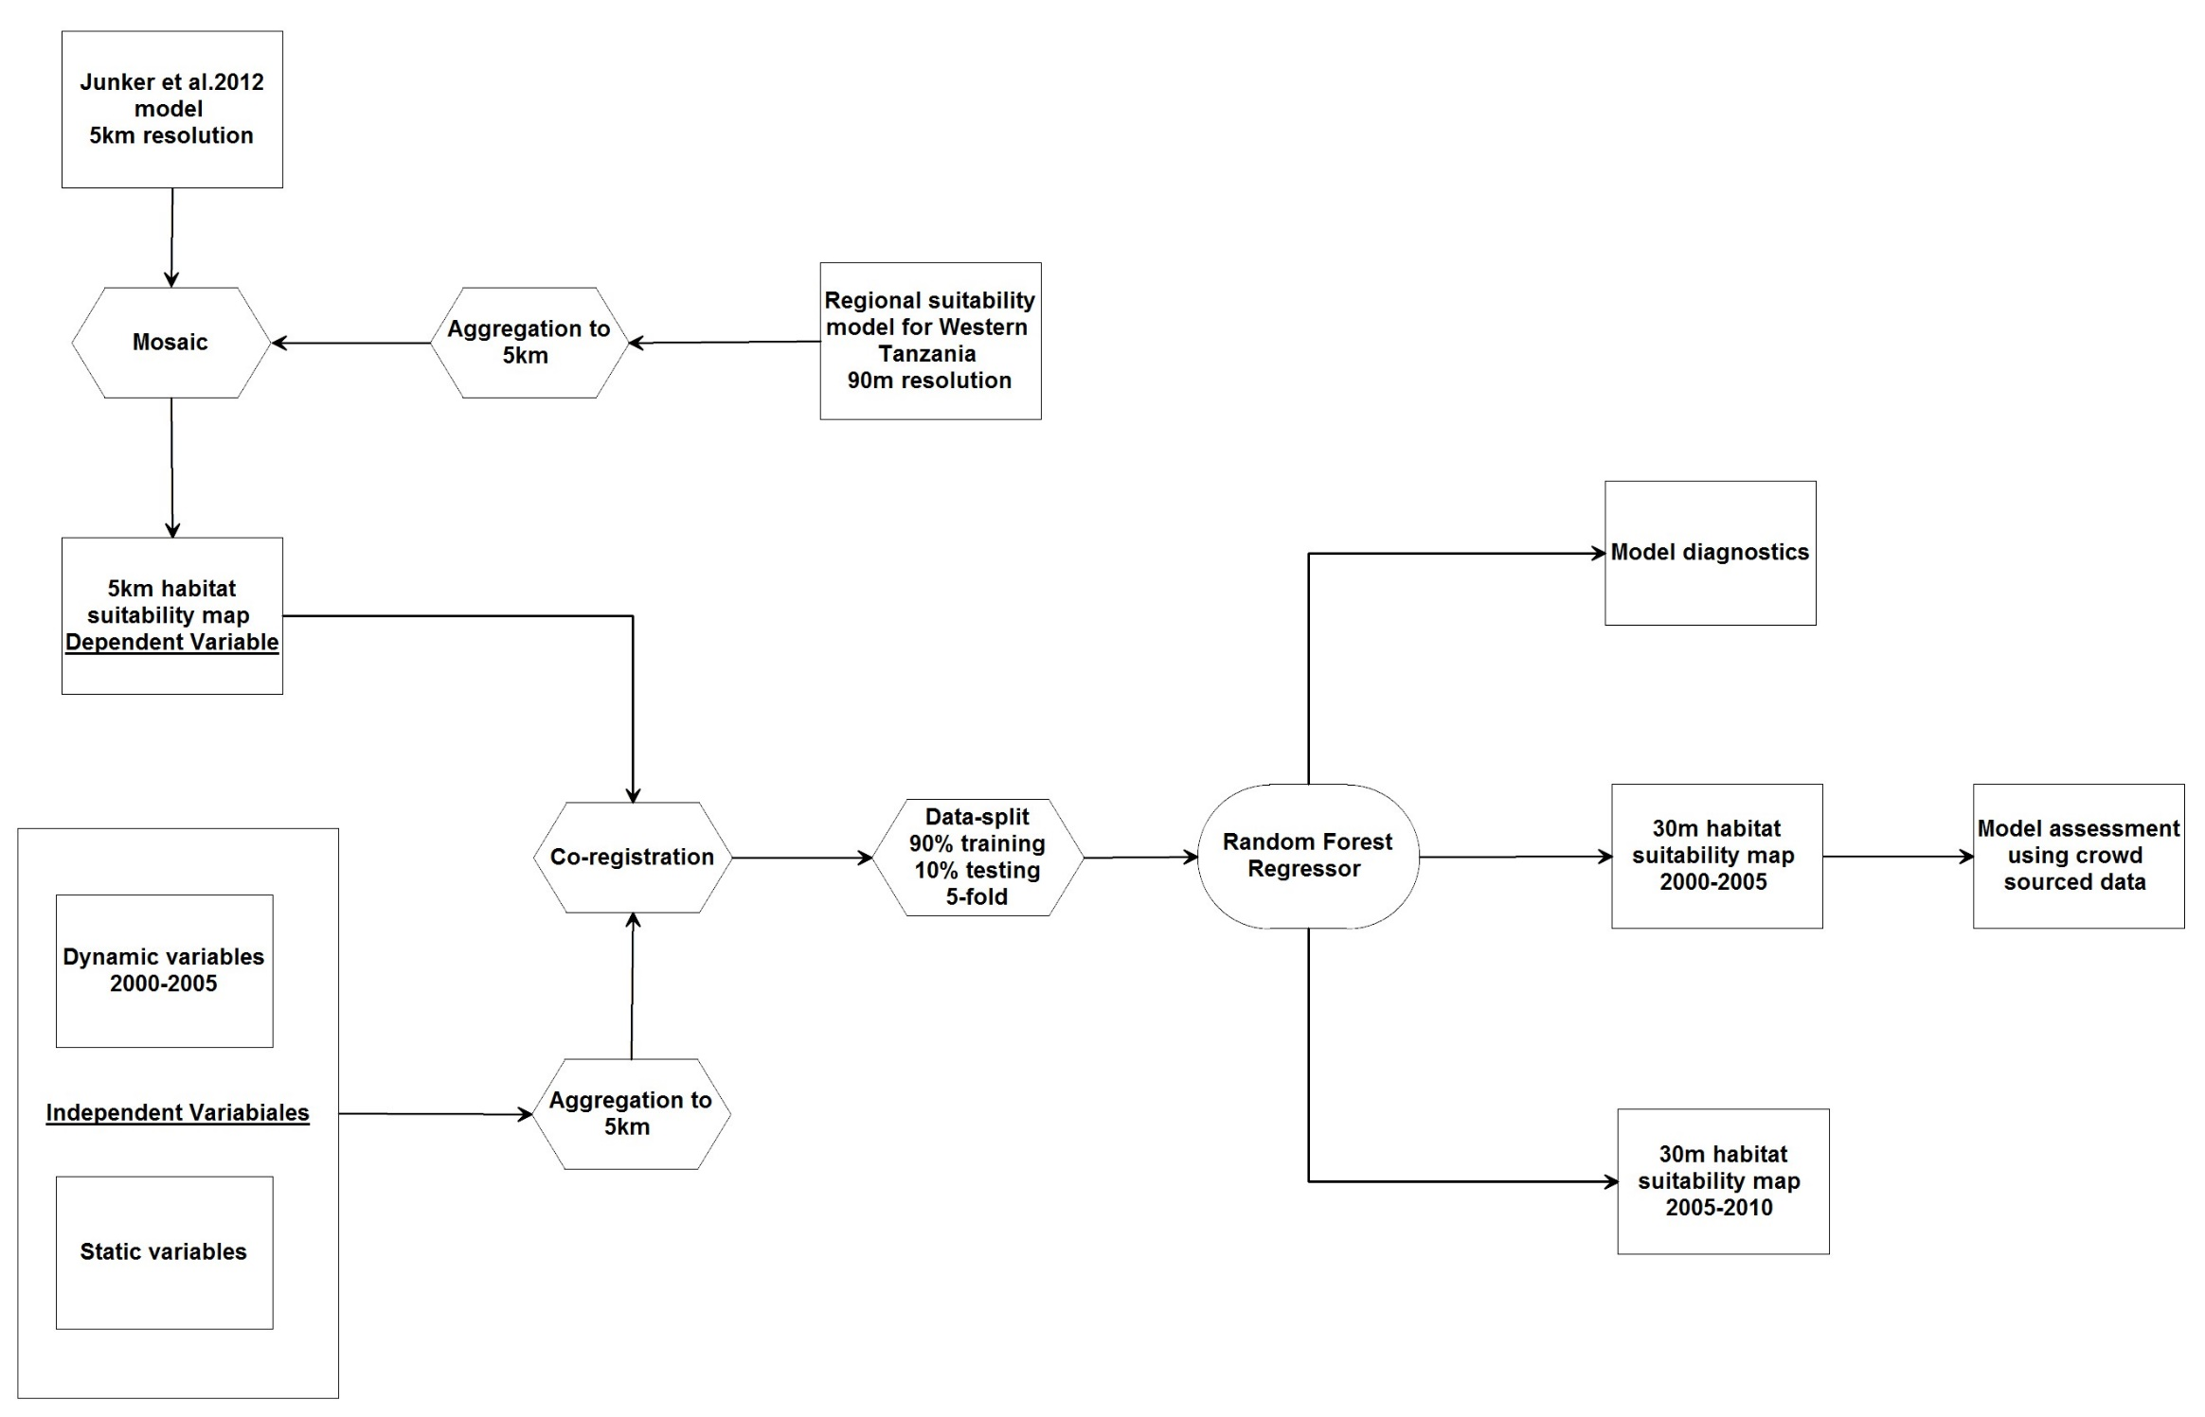
Work Flow

Slide 29
Input Data
Spectral
Band 3 median reflectance 2000-2005
Band 4 median reflectance 2000-2005
Band 5 median reflectance 2000-2005
Band 7 median reflectance 2000-2005
Normalized difference (band4/band3)
Normalized difference (band4/band5)
Normalized difference (band4/band7)
band3/band5
band3/band7
band5/band7
Forest structure
Percent canopy cover
Canopy height
Percent bare ground
Disturbance and fragmentation
Proximity to forest loss (minimum 0.5 ha)
Proximity of interior forest to forest edge (minimum 1 ha patch size)
Topographic
Elevation
Slope
Proximity to steep slopes (>15º)
Proximity to rivers
15 Landsat ETM+ based
“dynamic”
variables derived from Hansen et al. (2013) data.
5 Shuttle Radar Topography Mission based “static”
variables.

Slide 30
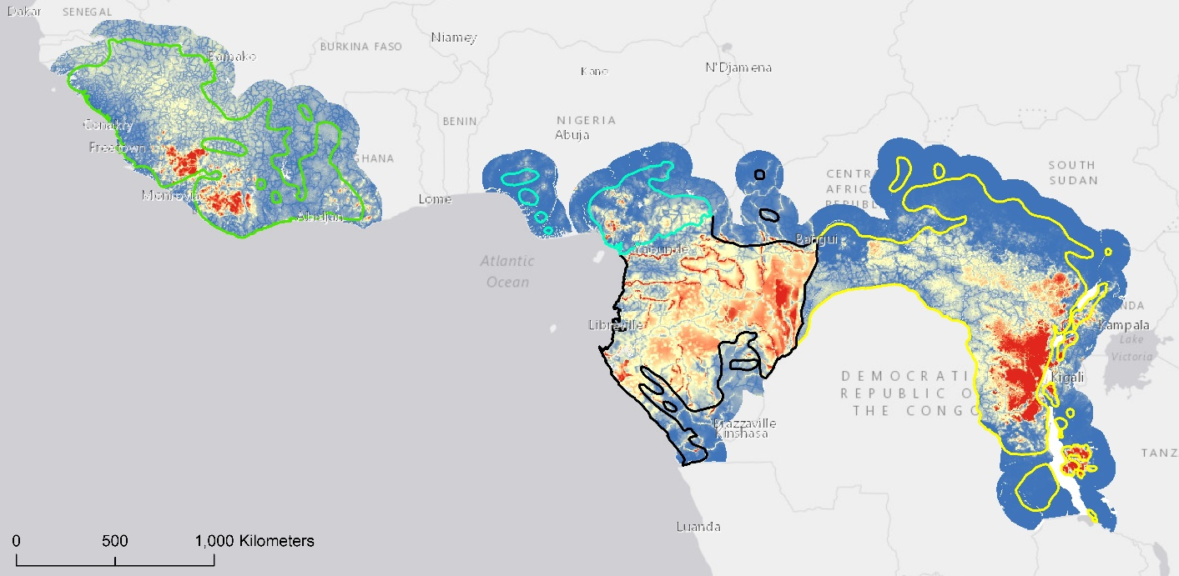
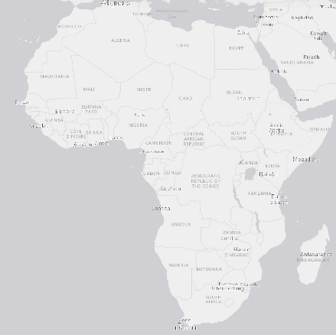
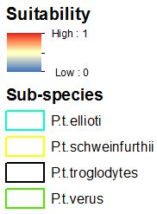
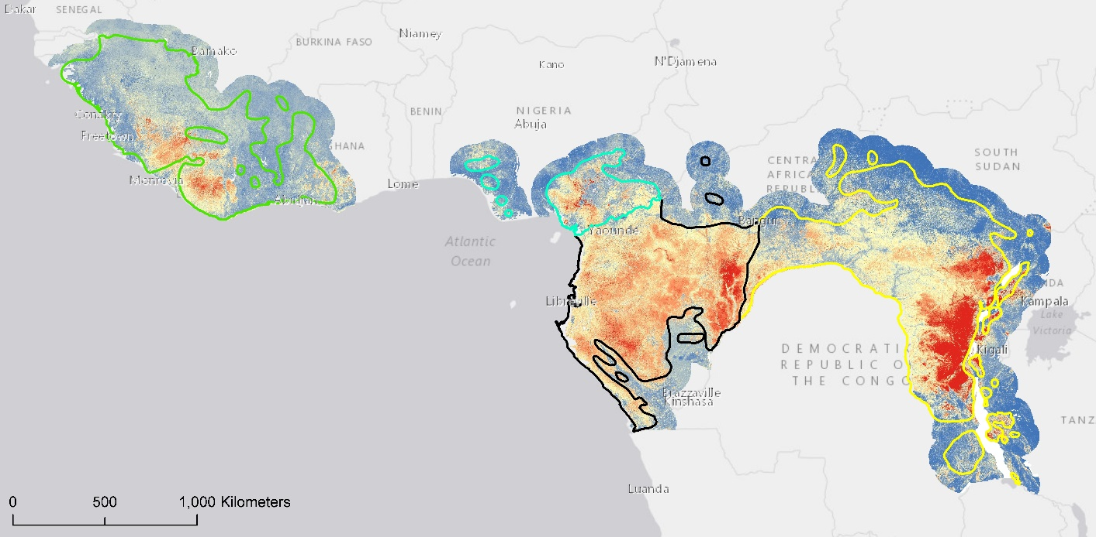
5km resolution
30m resolution

Slide 31
5km resolution
30m resolution

Slide 32
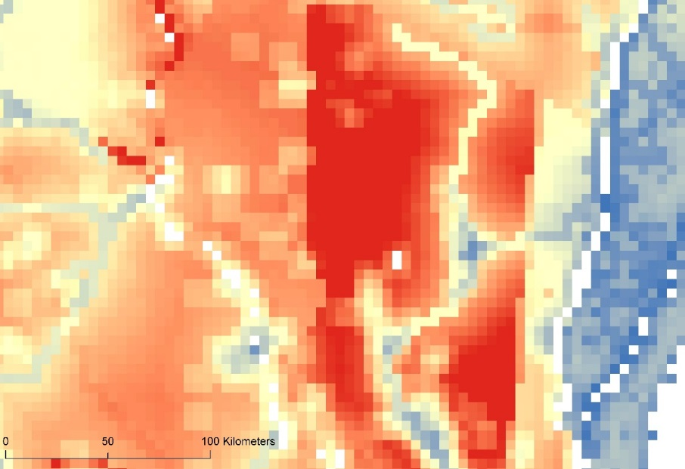
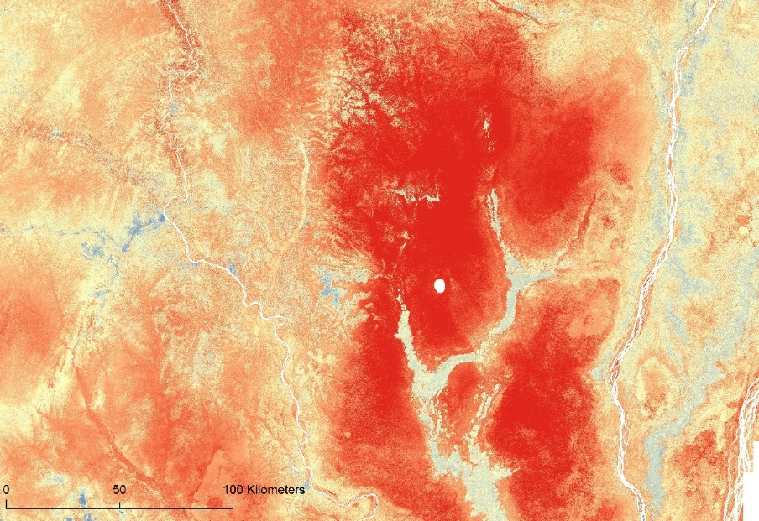

5km resolution
30m resolution

Slide 33
5km resolution
30m resolution

Slide 34
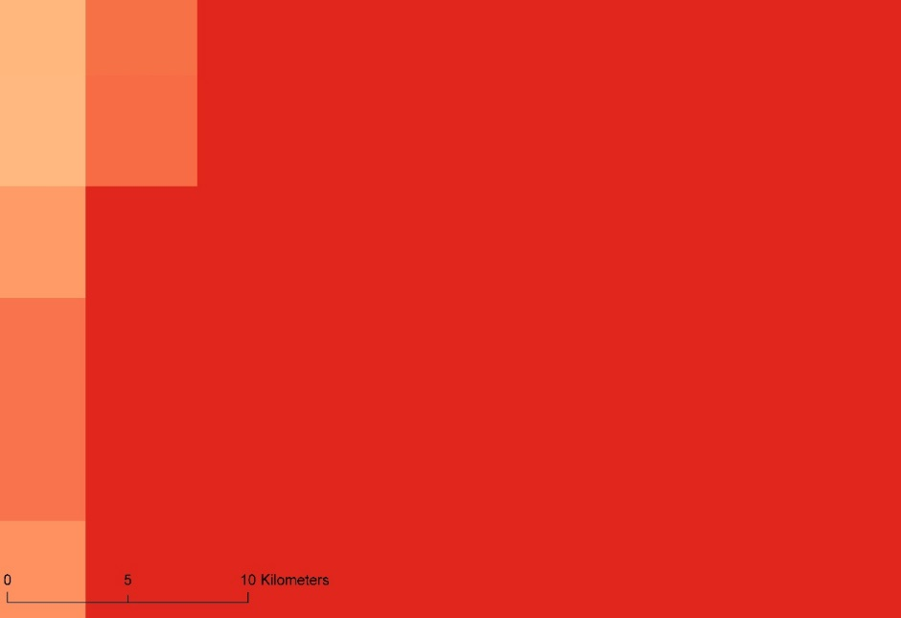
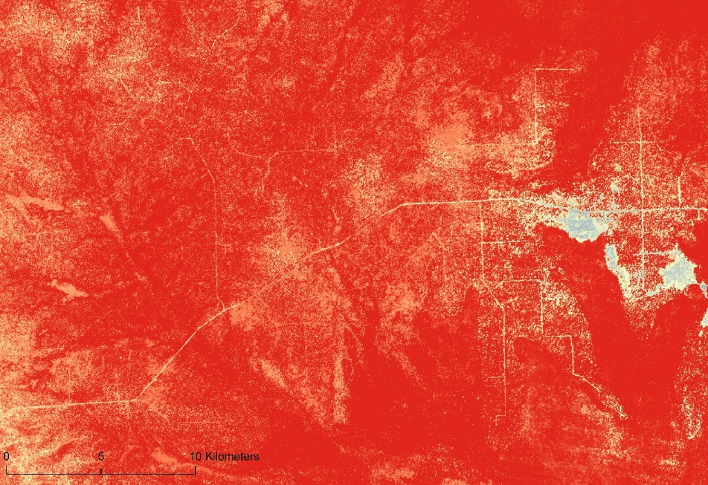
5km resolution
30m resolution

Slide 35
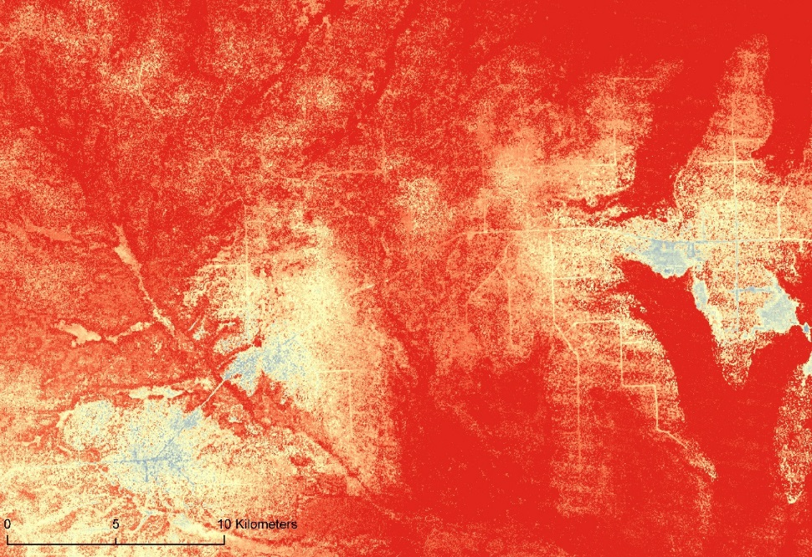
30m resolution 2000-2005
30m resolution 2005-2010

Slide 36
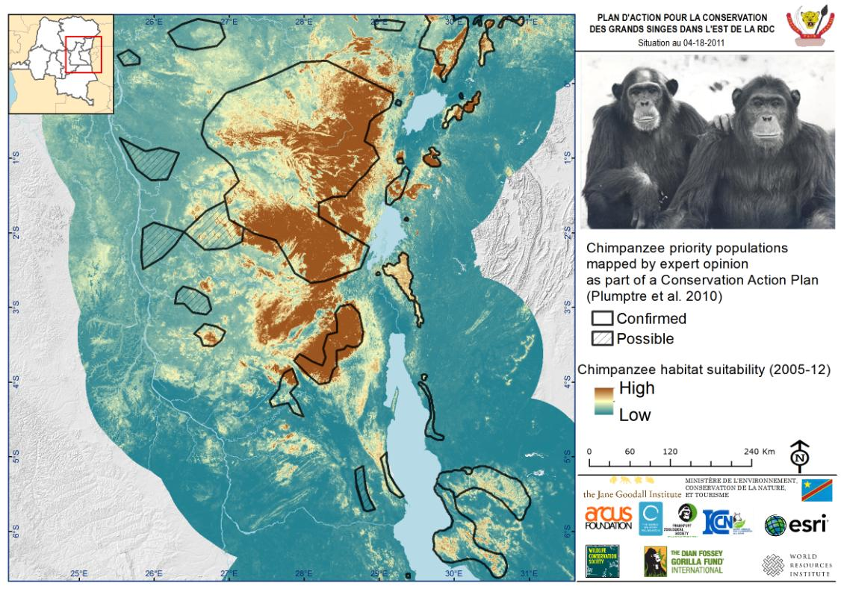

Slide 37
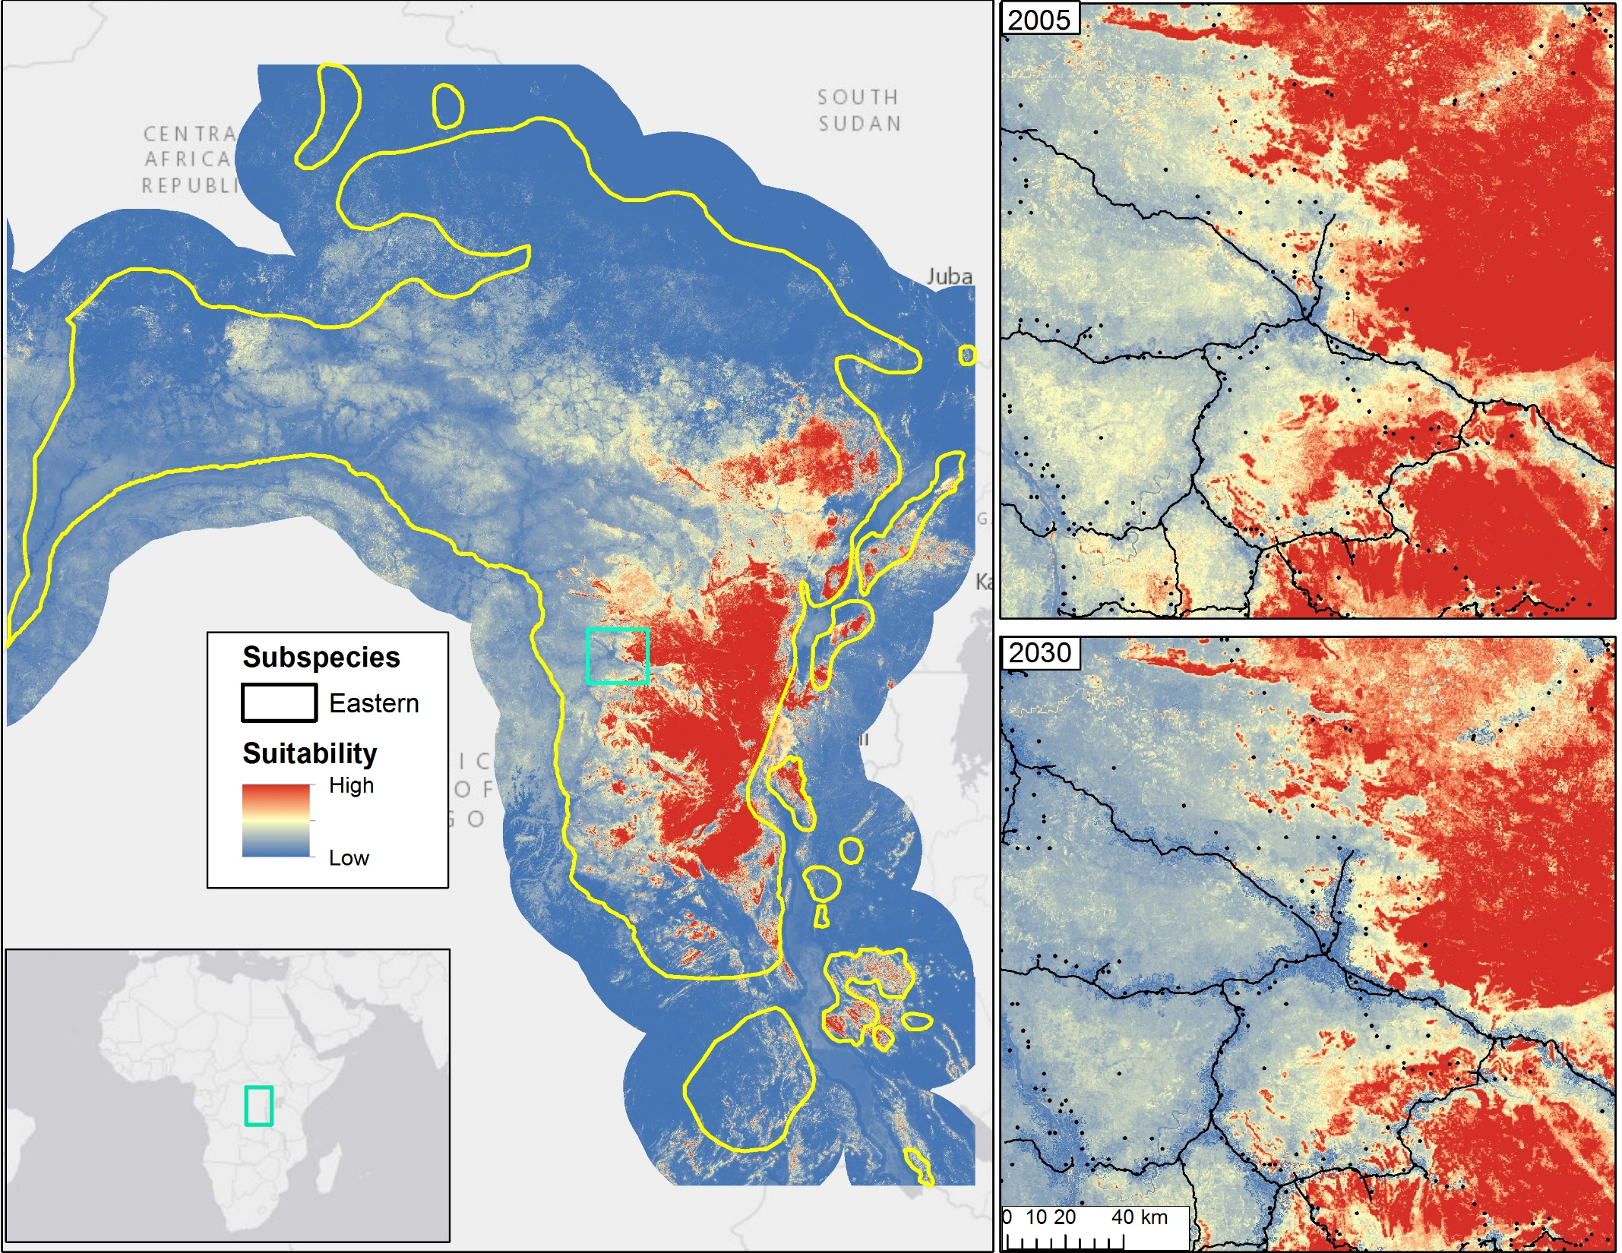

Slide 38
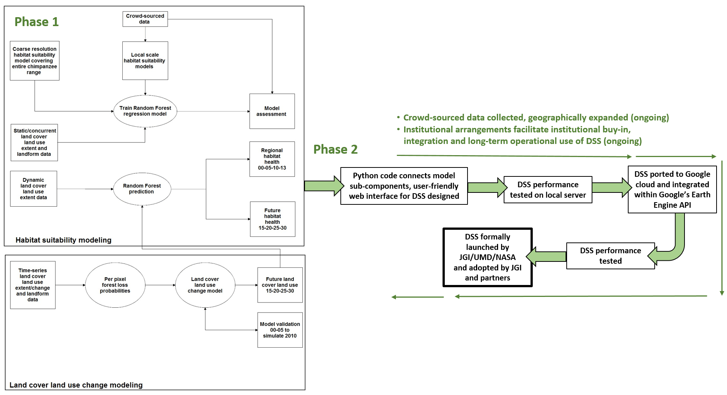


Phase 2 Plan
Steps to develop, test and validate the application
Phase 2 Plan
Steps to develop, test and validate the application

Slide 39












Local communities and Governments of Tanzania, DRC, Uganda and Republic of Congo
THANK YOU!

